Slide 1
Restoration of Ancient Indian Paintings using Pix2Pix and CycleGAN
- Sriram B 21BCE1674
-Shriman K.Arun 21BCE5351
-Anirudh N 21BCE1270

Slide 2
Introduction
Context: Ancient art represents invaluable cultural heritage but suffers from various forms of degradation over time, including fading, physical damage, and loss of detail.
Challenges: Traditional restoration methods can be time-consuming, costly, and may even risk damaging the artwork.
Solution Direction: Digital methods, particularly Generative Adversarial Networks (GANs), offer a promising approach for efficient and precise restoration.

Slide 3
Problem Statement
Degradation Issues: Ancient art often experiences discoloration, cracks, and even complete loss of sections over time, making traditional restoration difficult.
Limitations of Manual Restoration: Restorers face limitations in accuracy and may unintentionally alter the artwork’s original style.
Goal: Use GAN-based inpainting to digitally reconstruct missing sections and enhance the overall quality of degraded images.

Slide 4
Research Objectives
Objective 1: Develop a GAN-based approach for restoring missing or damaged portions in ancient artwork, ensuring style consistency with the original.
Objective 2: Apply image enhancement techniques to improve the visual quality and detail of degraded art pieces.
Objective 3: Evaluate the restored images using quantitative metrics to validate restoration quality.

Slide 5
Related Work
Previous Studies: Early works have explored basic digital inpainting and manual touch-ups for art restoration.
GAN Applications: Context Encoder and other GAN models have shown promise in filling missing sections in photos and images.
Research Gap: Existing methods often lack fine-grained control for art-specific styles, especially for ancient and complex art patterns.

Slide 6
Proposed System Overview
System Objective: To restore degraded Indian images using Pix2Pix and CycleGAN while comparing their performance in restoring texture, style, and structure.
Core Modules:
Data Preprocessing:
Pix2Pix: Paired datasets of noisy and clean images.
CycleGAN: Unpaired datasets of degraded and ground-truth images.
Model Implementation:
Pix2Pix: U-Net generator and PatchGAN discriminator.
CycleGAN: Dual generators with cycle consistency loss.
Evaluation Module:
Metrics: PSNR, SSIM, and visual analysis.

Slide 7
Pix2Pix Architecture
Generator:
U-Net structure for pixel-level accuracy.
Conditional GAN (cGAN) setup ensures dependency on paired datasets.
Discriminator:
PatchGAN evaluates local realism.
Workflow:
Aligned noisy and ground-truth images are fed for training.
Output aims to achieve pixel-perfect restoration.

Slide 8
CycleGAN Architecture
Generator A (Noisy → Ground Truth):
Transforms degraded images into clean outputs.
Generator B (Ground Truth → Noisy):
Ensures reverse consistency by recreating degraded images.
Discriminators:
Evaluate the authenticity of images in both domains.
Cycle Consistency Loss:
Maintains structural integrity and style preservation.

Slide 9
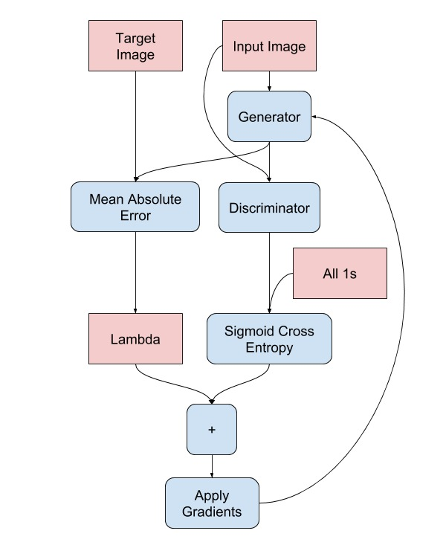
System Pipeline
Preprocessing:
Paired and unpaired datasets prepared for training.
Training:
Pix2Pix uses L1 loss and GAN loss for pixel-perfect outputs.
CycleGAN ensures domain mapping through unpaired learning.
Restoration:
Restored outputs generated post-training.
Evaluation:
Metrics like PSNR and SSIM assess restoration quality.

Slide 10
GAN Techniques for Image Restoration
Pix2Pix Highlights:
Ideal for scenarios with well-aligned paired datasets.
Achieves high detail retention.
CycleGAN Highlights:
Versatile with unpaired datasets.
Preserves stylistic features and textures.
Key Differences:
Dataset dependency: Pix2Pix (paired) vs. CycleGAN (unpaired).
Architectural focus on consistency for CycleGAN.

Slide 11
Results
Metrics Used:
PSNR (Peak Signal-to-Noise Ratio): Measures pixel similarity between original and restored images.
SSIM (Structural Similarity Index): Evaluates consistency in structural details.
Results Overview:
Pix2Pix:
PSNR: 18.51
SSIM: 0.6838
Analysis: While Pix2Pix shows relatively lower PSNR and SSIM values, the restoration is quite effective in terms of fine-grained details and pixel-level alignment in the paired dataset.
CycleGAN:
PSNR: 32.30
SSIM: 0.8120
Analysis: CycleGAN performs significantly better in both PSNR and SSIM, demonstrating its ability to restore images more effectively, especially in unpaired datasets. It excels in texture and style preservation while maintaining structural integrity.

Slide 12
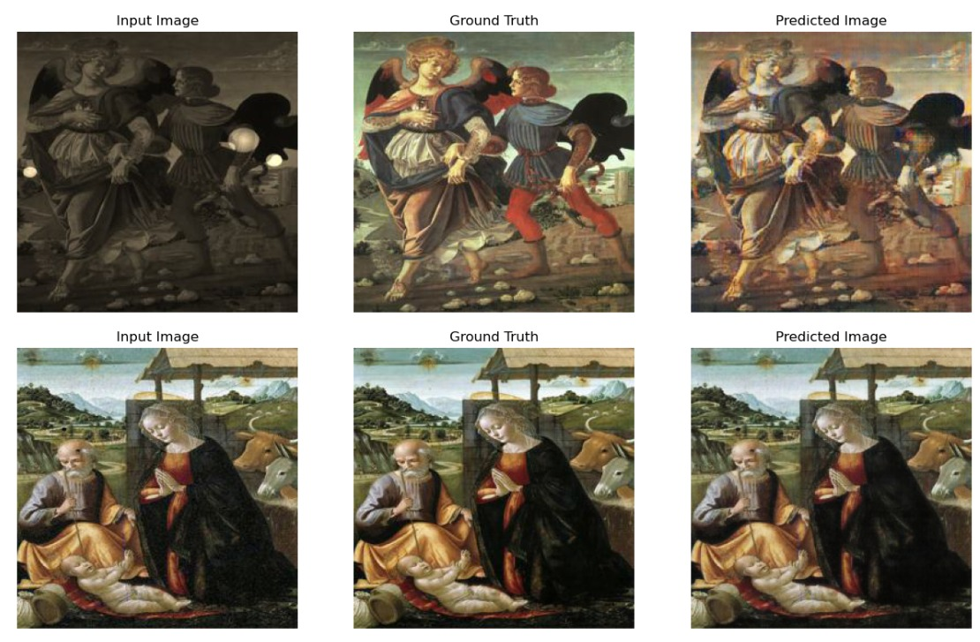
Results
Pix2Pix:

Slide 13
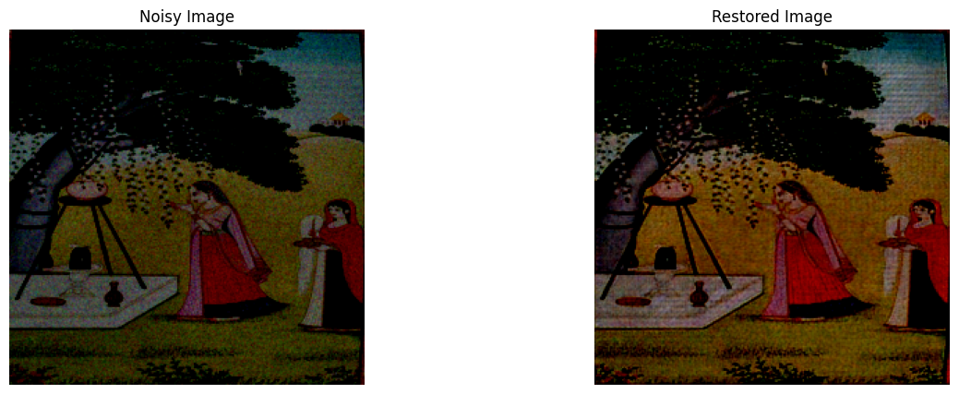
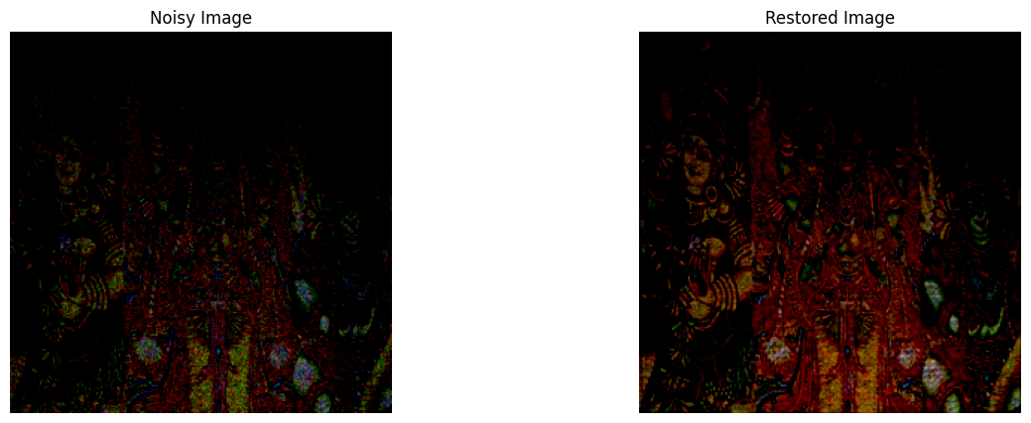
Results
CycleGAN:

Slide 14
Future Scope
Extended Restoration:
Old manuscripts and sculptures.
Video-based cultural preservation.
Advanced Architectures:
Incorporate attention mechanisms for finer details.
Hybrid models combining Pix2Pix and CycleGAN.
Global Impact:
Collaborate with museums and archives worldwide.

Slide 15
Thank You

